Slide 1
Review from Last Lecture and Today’s Content
Last time we saw:
Basic stream building overview
  Basic nodes like type, filter, derive, etc.
Data Cleaning techniques in Modeler
  Data Audit Node
Graphs for Visualization
  Graphboard and other Graph Nodes
Today we will continue with data cleaning, integration, transformation, and discretization

Slide 2
Chapter 3: Data Preprocessing
Data Preprocessing: An Overview
  Data Quality
  Major Tasks in Data Preprocessing
Data Cleaning
Data Integration
Data Reduction
Data Transformation and Data Discretization
Summary

Slide 3
Data Quality: Why Preprocess the Data?
Measures for data quality: A multidimensional view
  Accuracy: correct or wrong, accurate or not
  Completeness: not recorded, unavailable, …
  Consistency: some modified but some not, dangling, …
  Timeliness: timely update?
  Believability: how trustable the data are correct?
  Interpretability: how easily the data can be understood?

Slide 4
Why Is Data Preprocessing Important?
No quality data, no quality mining results!
  Quality decisions must be based on quality data
    e.g., duplicate or missing data may cause incorrect or even misleading statistics.
  Data warehouse needs consistent integration of quality data
Data extraction, cleaning, and transformation comprises the majority of the work of building a data warehouse
Data Mining: Concepts and Techniques

Slide 5
Major Tasks in Data Preprocessing
Data cleaning
  Fill in missing values, smooth noisy data, identify or remove outliers, and resolve inconsistencies
Data integration
  Integration of multiple databases, data cubes, or files
Data reduction
  Dimensionality reduction
  Numerosity reduction
  Data compression
Data transformation and data discretization
  Normalization
  Concept hierarchy generation

Slide 6
Chapter 3: Data Preprocessing
Data Preprocessing: An Overview
  Data Quality
  Major Tasks in Data Preprocessing
Data Cleaning
Data Integration
Data Reduction
Data Transformation and Data Discretization
Summary

Slide 7
Data Cleaning
Data in the Real World Is Dirty: Lots of potentially incorrect data, e.g., instrument faulty, human or computer error, transmission error
  incomplete: lacking attribute values, lacking certain attributes of interest, or containing only aggregate data
    e.g., Occupation=“ ” (missing data)
  noisy: containing noise, errors, or outliers
    e.g., Salary=“−10” (an error)
  inconsistent: containing discrepancies in codes or names, e.g.,
    Age=“42”, Birthday=“03/07/2010”
    Was rating “1, 2, 3”, now rating “A, B, C”
    discrepancy between duplicate records
  Intentional (e.g., disguised missing data)
    Jan. 1 as everyone’s birthday?

Slide 8
Incomplete (Missing) Data
Data is not always available
  E.g., many tuples have no recorded value for several attributes, such as customer income in sales data
Missing data may be due to
  equipment malfunction
  inconsistent with other recorded data and thus deleted
  data not entered due to misunderstanding
  certain data may not be considered important at the time of entry
  not register history or changes of the data
Missing data may need to be inferred

Slide 9
How to Handle Missing Data?
Ignore the tuple: usually done when class label is missing (when doing classification)—not effective when the % of missing values per attribute varies considerably
Fill in the missing value manually: tedious + infeasible?
Fill in it automatically with
  a global constant : e.g., “unknown”, a new class?!
  the attribute mean
  the attribute mean for all samples belonging to the same class: smarter
  the most probable value: inference-based such as Bayesian formula or decision tree

Slide 10
Noisy Data
Noise: random error or variance in a measured variable
Incorrect attribute values may be due to
  faulty data collection instruments
  data entry problems
  data transmission problems
  technology limitation
  inconsistency in naming convention
Other data problems which require data cleaning
  duplicate records
  incomplete data
  inconsistent data

Slide 11
How to Handle Noisy Data?
Binning
  first sort data and partition into (equal-frequency) bins
  then one can smooth by bin means, smooth by bin median, smooth by bin boundaries, etc.
Regression
  smooth by fitting the data into regression functions
Clustering
  detect and remove outliers
Combined computer and human inspection
  detect suspicious values and check by human (e.g., deal with possible outliers)

Slide 12
Data Cleaning as a Process
Data discrepancy detection
  Use metadata (e.g., domain, range, dependency, distribution)
  Check field overloading
  Check uniqueness rule, consecutive rule and null rule
  Use commercial tools
    Data scrubbing: use simple domain knowledge (e.g., postal code, spell-check) to detect errors and make corrections
    Data auditing: by analyzing data to discover rules and relationship to detect violators (e.g., correlation and clustering to find outliers)
Data migration and integration
  Data migration tools: allow transformations to be specified
  ETL (Extraction/Transformation/Loading) tools: allow users to specify transformations through a graphical user interface
Integration of the two processes
  Iterative and interactive (e.g., Potter’s Wheels)

Slide 13
Chapter 3: Data Preprocessing
Data Preprocessing: An Overview
  Data Quality
  Major Tasks in Data Preprocessing
Data Cleaning
Data Integration
Data Reduction
Data Transformation and Data Discretization
Summary

Slide 14
Data Integration
Data integration:
  Combines data from multiple sources into a coherent store
Schema integration: e.g., A.cust-id ≡ B.cust-#
  Integrate metadata from different sources
Entity identification problem:
  Identify real world entities from multiple data sources, e.g., Bill Clinton = William Clinton
Detecting and resolving data value conflicts
  For the same real world entity, attribute values from different sources are different
  Possible reasons: different representations, different scales, e.g., metric vs. British units

Slide 15
Handling Redundancy in Data Integration
Redundant data occur often when integration of multiple databases – Merge Node – will see examples later
  Object identification: The same attribute or object may have different names in different databases
  Derivable data: One attribute may be a “derived” attribute in another table, e.g., annual revenue
Redundant attributes may be able to be detected by correlation analysis
Careful integration of the data from multiple sources may help reduce/avoid redundancies and inconsistencies and improve mining speed and quality – some methods handle correlated variables better than others

Slide 16
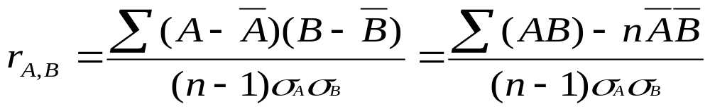


Correlation Analysis (Numerical Data)
Correlation coefficient (also called Pearson’s product moment coefficient)
  where n is the number of tuples, and are the respective means of A and B, σ_{A} and σ_{B} are the respective standard deviation of A and B, and Σ(AB) is the sum of the AB cross-product.
If r_{A,B} > 0, A and B are positively correlated (A’s values increase as B’s). The higher, the stronger correlation.
r_{A,B} = 0: independent; r_{A,B} < 0: negatively correlated
Statistics and Feature Selection Nodes in Modeler

Slide 17

Visually Evaluating Correlation
Scatter plots showing the similarity from –1 to 1.

Slide 18



Covariance (Numeric Data)
Covariance is similar to correlation
  where n is the number of tuples, and are the respective mean or expected values of A and B, σ_{A} and σ_{B} are the respective standard deviation of A and B.
Positive covariance: If Cov_{A,B} > 0, then A and B both tend to be larger than their expected values.
Negative covariance: If Cov_{A,B} < 0 then if A is larger than its expected value, B is likely to be smaller than its expected value.
Independence: Cov_{A,B} = 0 but the converse is not true:
  Some pairs of random variables may have a covariance of 0 but are not independent. Only under some additional assumptions (e.g., the data follow multivariate normal distributions) does a covariance of 0 imply independence
Correlation coefficient:

Slide 19

Correlation Analysis (Categorical Data)
Χ² (chi-square) test
The larger the Χ² value, the more likely the variables are related
The cells that contribute the most to the Χ² value are those whose actual count is very different from the expected count
Matrix Node and Feature Selection Nodes
Correlation does not imply causality
  # of hospitals and # of car-theft in a city are correlated
  Both are causally linked to the third variable: population

Slide 20
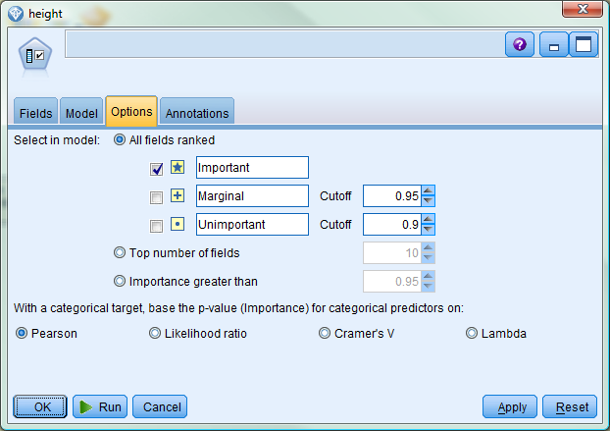
This is the Feature Selection Node Option Tab
Pearson is the Chi-Square Test

Slide 21
Chi-Square Calculation: An Example (See Slide notes for expected counts help)
Need at least 5 expected values in each cell (preferably more) for chi-square test
Χ² (chi-square) calculation (numbers in parenthesis are expected counts calculated based on the data distribution in the two categories)
Consult chi-square table with (rows-1)*(cols-1) = 1 degrees freedom. It is 10.28 at significance 0.001 and thus shows that like_science_fiction and play_chess are correlated in the group
 | Play chess | Not play chess | Sum (row)
Like science fiction | 250(90) | 200(360) | 450
Not like science fiction | 50(210) | 1000(840) | 1050
Sum(col.) | 300 | 1200 | 1500
Notes:
Ratio of 300/1500 = 0.2 = 90/450 = 210/1050 which give the expected counts in column 1. E.g for the upper left cell, solve 300/1500 = x/450 to get x = 90. Do the same for the other cells to get the expected counts.
Ratıo of 1200/1500 = 0.8 = 360/450 = 840/1050 which give the expected counts in column 2.

Slide 22
Chapter 3: Data Preprocessing
Data Preprocessing: An Overview
  Data Quality
  Major Tasks in Data Preprocessing
Data Cleaning
Data Integration
Data Reduction
Data Transformation and Data Discretization
Summary

Slide 23
Data Reduction Strategies
Why data reduction?
  A database/data warehouse may store terabytes of data
  Complex data analysis/mining may take a very long time to run on the complete data set
Data reduction
  Obtain a reduced representation of the data set that is much smaller in volume but yet produce the same (or almost the same) analytical results
Data reduction strategies – will cover regression, cluster analysis, CHAID (like Chimerge), C5.0 (entropy) later
  Data cube aggregation:
  Dimensionality reduction — e.g., remove unimportant attributes
  Data Compression
  Numerosity reduction — e.g., fit data into models
  Discretization and concept hierarchy generation

Slide 24
Data Cube Aggregation
Aggregate Node in Modeler
The lowest level of a data cube (base cuboid)
  The aggregated data for an individual entity of interest
  E.g., a customer in a phone calling data warehouse
Multiple levels of aggregation in data cubes
  Further reduce the size of data to deal with
Reference appropriate levels
  Use the smallest representation which is enough to solve the task
Queries regarding aggregated information should be answered using data cube, when possible

Slide 25
Attribute Subset Selection
Feature Selection Node (i.e., attribute subset selection):
  Select a minimum set of features such that the probability distribution of different classes given the values for those features is as close as possible to the original distribution given the values of all features
  reduce # of patterns in the patterns, easier to understand
Heuristic methods – Options in some Modeler Nodes (e.g. regression nodes) (due to exponential # of choices):
  Step-wise forward selection
  Step-wise backward elimination
  Combining forward selection and backward elimination

Slide 26
Chapter 3: Data Preprocessing
Data Preprocessing: An Overview
  Data Quality
  Major Tasks in Data Preprocessing
Data Cleaning
Data Integration
Data Reduction
Data Transformation and Data Discretization
Summary

Slide 27
Data Transformation
Smoothing: remove noise from data
Aggregation: summarization, data cube construction
Generalization: concept hierarchy climbing
Normalization: scaled to fall within a small, specified range
  min-max normalization
  z-score normalization
  normalization by decimal scaling
Attribute/feature construction
  New attributes constructed from the given ones

Slide 28




Data Transformation: Normalization – Auto Data Preparation Node
Min-max normalization: to [new_min_{A}, new_max_{A}]
  Ex. Let income range $12,000 to $98,000 normalized to [0.0, 1.0]. Then $73,000 is mapped to
Z-score normalization (μ: mean, σ: standard deviation):
  Ex. Let μ = 54,000, σ = 16,000. Then
Modeler Auto Data Prep Node can do this automatically

Slide 29
Simple Discretization Methods: Binning Node
Equal-width (distance) partitioning
  Divides the range into N intervals of equal size: uniform grid
  if A and B are the lowest and highest values of the attribute, the width of intervals will be: W = (B –A)/N.
  The most straightforward, but outliers may dominate presentation
  Skewed data is not handled well
Equal-depth (frequency) partitioning
  Divides the range into N intervals, each containing approximately same number of samples
  Good data scaling
  Managing categorical attributes can be tricky

Slide 30
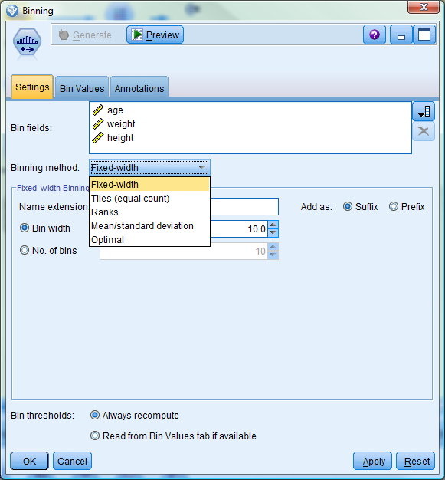
Binning Node pull-down allows selection of binning type

Slide 31
References
D. P. Ballou and G. K. Tayi. Enhancing data quality in data warehouse environments. Communications of ACM, 42:73-78, 1999
T. Dasu and T. Johnson. Exploratory Data Mining and Data Cleaning. John Wiley & Sons, 2003
T. Dasu, T. Johnson, S. Muthukrishnan, V. Shkapenyuk. Mining Database Structure; Or, How to Build a Data Quality Browser. SIGMOD’02.
H.V. Jagadish et al., Special Issue on Data Reduction Techniques. Bulletin of the Technical Committee on Data Engineering, 20(4), December 1997
D. Pyle. Data Preparation for Data Mining. Morgan Kaufmann, 1999
E. Rahm and H. H. Do. Data Cleaning: Problems and Current Approaches. IEEE Bulletin of the Technical Committee on Data Engineering. Vol.23, No.4
V. Raman and J. Hellerstein. Potters Wheel: An Interactive Framework for Data Cleaning and Transformation, VLDB’2001
T. Redman. Data Quality: Management and Technology. Bantam Books, 1992
Y. Wand and R. Wang. Anchoring data quality dimensions ontological foundations. Communications of ACM, 39:86-95, 1996
R. Wang, V. Storey, and C. Firth. A framework for analysis of data quality research. IEEE Trans. Knowledge and Data Engineering, 7:623-640, 1995

